Slide 1

TEAM TWO - DAMPP
Iteration 0 Github Link: https://github.com/BUMETCS673/project-microserviceteamtwo

Slide 2
Team Members | Roles
Praveen Singh | Team Lead
Pranjal Ekhande | Requirement Lead
Dipayan Mazumder | Security Lead
Aman Jain | Configuration Lead , QA Lead
Mukul Jangid | Design and Implementation Lead

Slide 3
INTRODUCTION - ProManage
ProManage project management platform to streamline project creation, editing, management, search, and rating processes.
Offers project-based learning for students and professionals.
The platform will provide an environment where users can create and manage projects, access learning resources, collaborate with team members, and receive assessments and feedback on their work.
With ProManage which empowers organizations and institutions to effectively plan, execute, and monitor projects with ease.
Users will be able to optimize resources, mitigate risks and deliver projects on time and within budget.

Slide 4
Project Planning
Iteration | Functional Requirements(Essential/Disable/Option) | Tasks (Cross requirements tasks) | Estimated/real person hours
1 | Iteration 0 | Environment Setup, Documentation, Initialisation | 50 - 60
2 | Iteration 1 Code Skeleton Project Creation | Design, Implementation, Testing | 150 - 160
3 | Project Search and Filtering (Essential) Project Reporting and Analytics (Desirable) | Design, Implementation, Testing Design, Implementation, Testing | TBD TBD
4 | Integration with Other Services (Desirable) Project Templates (Desirable) Optional Features (if time permits) | Design, Implementation, Testing Design, Implementation, Testing | TBD TBD

Slide 5
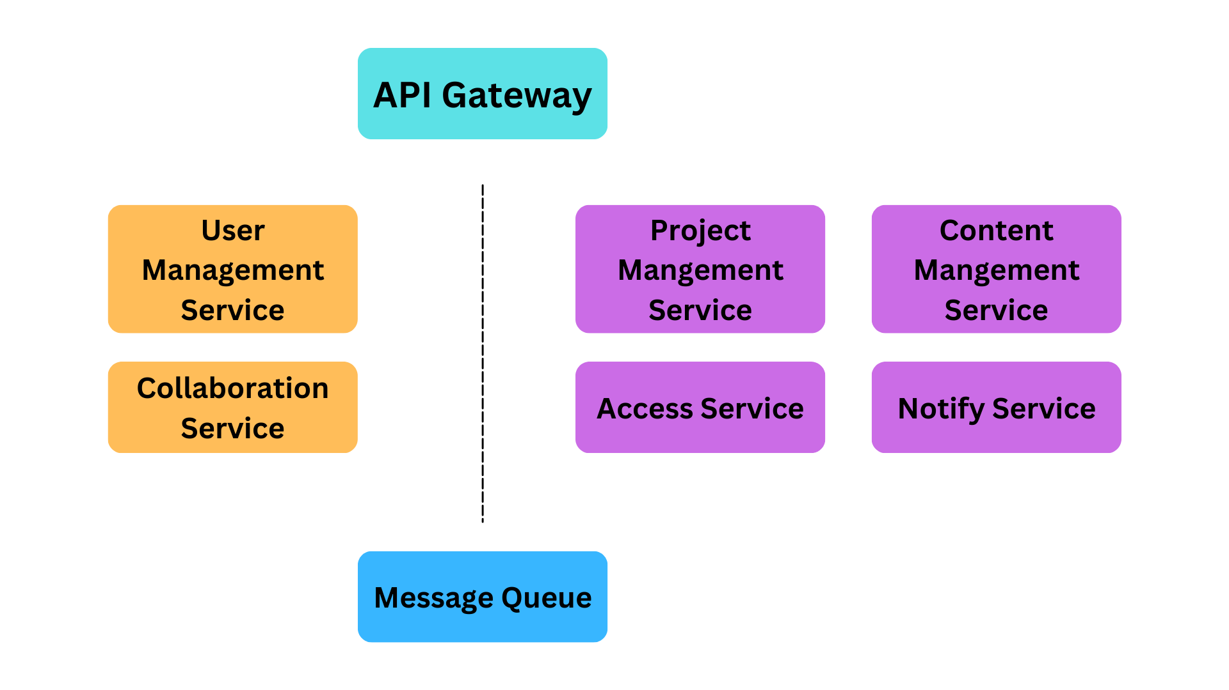
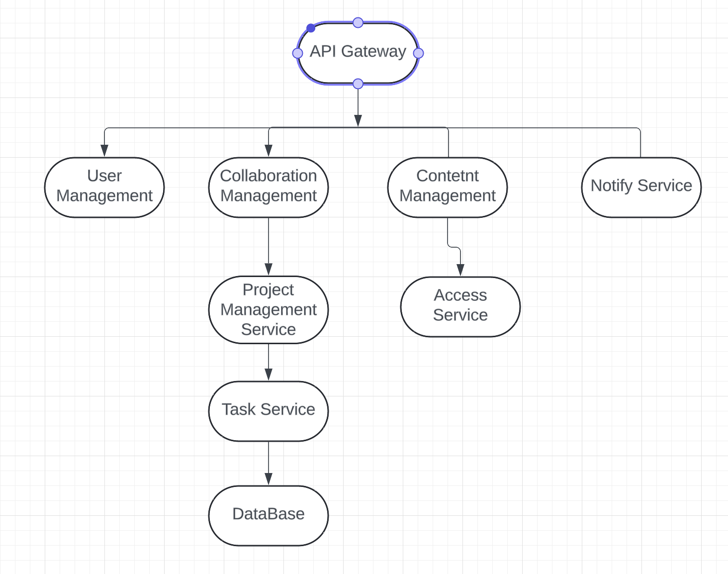
Architectural Diagram

Slide 6
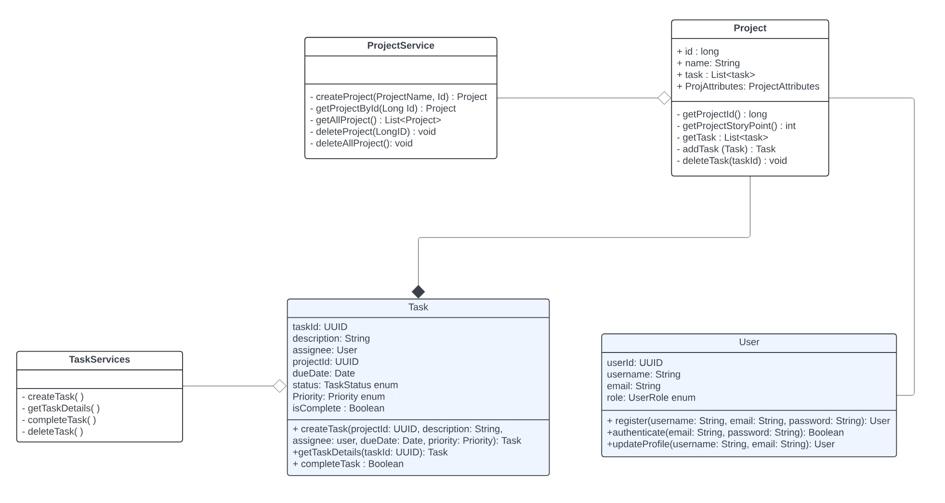
Class Diagram

Slide 7
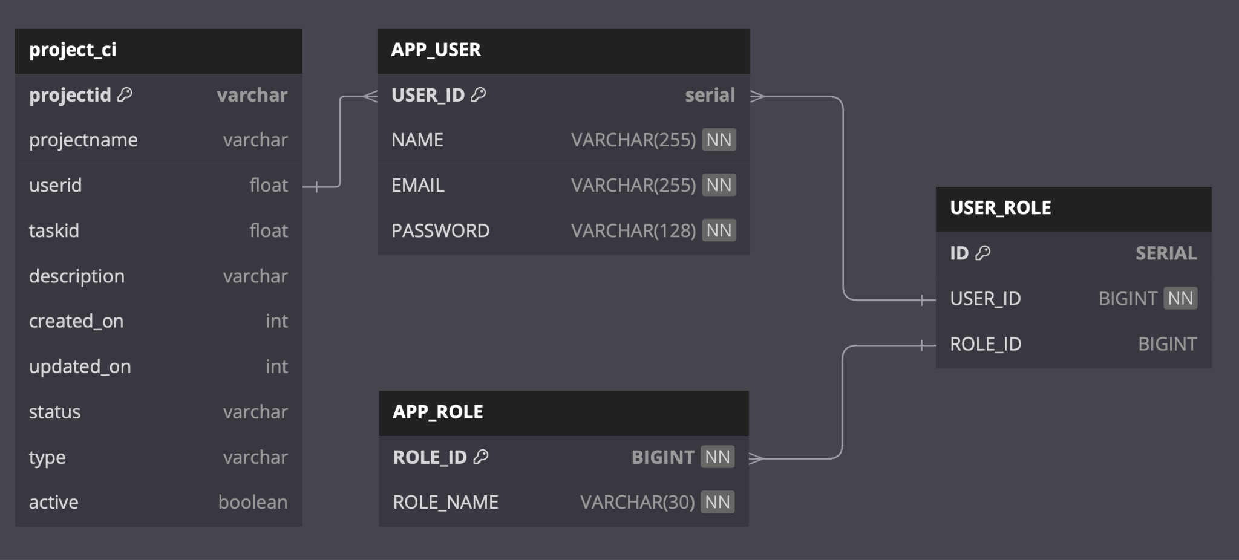
Database Diagram

Slide 8
CONFIGURATION TOOLS
Version control - Git and Github
IDE - IntelliJ / Spring Tool Suite Spring
CICD - Github
Dependency Management - Maven

Slide 9
Code Review Process
For Development branch the following processes will be followed:
Development branch -> Dev Testing -> PR raise -> peer review -> Testing -> Dev (preprod) -> Prod -> Ticket close
Peer Review would be mainly done by Mukul and Pranjal.

Slide 10
TESTING & QA
Our team will use Google Java Coding Standards for writing all the java code and Black code style for writing Python code.
For manual testing we will cover exploratory testing, usability testing and regression testing.
For automation testing we will include unit testing and integration testing.
We will use JUnit for Java testing
We will use Postman for API testing

Slide 11
QA Matrix
Metric Name | Description
Code Duplication | Monitor the percentage of duplicate code across the codebase to identify opportunities for code reuse and maintainability improvements.
Code coverage | Measure the percentage of code covered by unit tests to ensure adequate testing of the codebase.
Maintainability Index | Evaluate the maintainability of the codebase based on factors like code complexity, duplication, and adherence to coding standards.
Test Execution Time | Measure the time taken to execute the entire test suite, which can indicate the need for test optimization or parallelization.

Slide 12
THANK YOU

